Slide 1

Document Design

Slide 2
Importance of Document Design
If you give your readers excessively long paragraphs, or pages full of wall‐to‐wall words, you have made a mistake.
In contrast, effective technical communication allows readers rapid access to the information, highlights important information, and graphically expresses your company’s identity.

Slide 3

Document Design
The Technical Communication Context
Damages and Dangers: If your intended readers fail to read your text because it is visually inaccessible, imagine the possible repercussions.
Corporate Identity: Visually unappealing and inaccessible correspondence can negatively affect your company’s sales and reputation. Document design is one way to appeal to a client.
Time and Money

Slide 4
Document Design
Organization
Access
Variety
break text into smaller chunks of information- chunking
White space (horizontal spacing between paragraphs, created by double‐ or triplespacing)
Rules (horizontal lines typed across the page to separate units of information)
Section dividers and tabs (used in longer reports to create smaller units)
Headings and talking headings
Headings—words or phrases such as “Introduction,” “Discussion,” “Conclusion,”
more informative than headings.
“Human Resources Committee Reviews 2014 Benefits Packages,”
Order

Slide 5
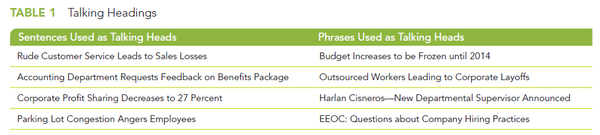
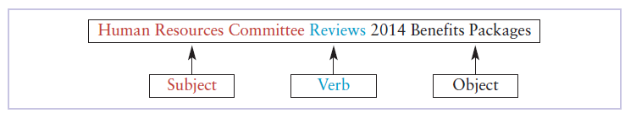
Talking Headings

Slide 6
Document Design
Organization
Order
Access
Variety
Typeface
Serif-commonly used in text
Sans Serif-best used for headings
Density-created by boldfacing words
Times New Roman, Arial, and Calibri-letters, memos, e-mails, reports, resumes, proposals
Arial and Verdana- best for Web sites
Spacing
Position
headings can be centered
aligned with the left margin
indented, or outdented (hung heads)
Consistency is the key.

Slide 7
Access
White space
Bullets
asterisks (*), hyphens (‐), a lowercase o, degree signs (°), typographic symbols (■, ❑, ●, or ◆), or iconic webdings and wingdings (☞, 6, or ✓)
Numbering-show sequence or importance
Boldface
Underlining
Italics
Text boxes
Fills
Inverse type
printing white on black—versus the usual black on white.
Color
access information rapidly—at a glance
All caps-WARNING, DANGER, CAUTION, or NOTE

Slide 8

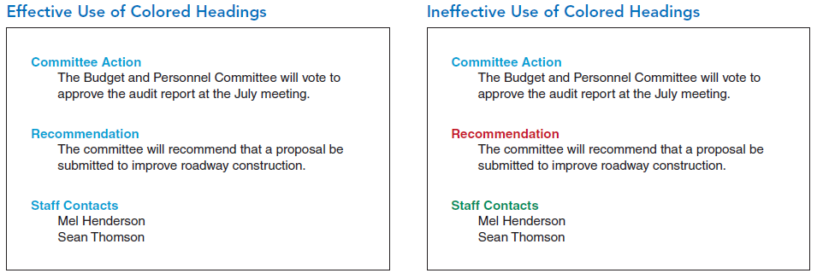

Slide 9
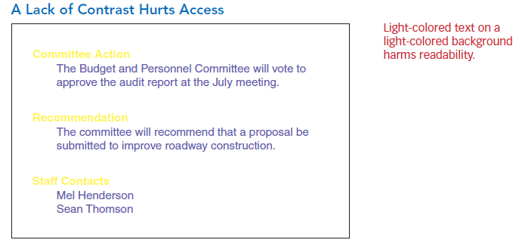
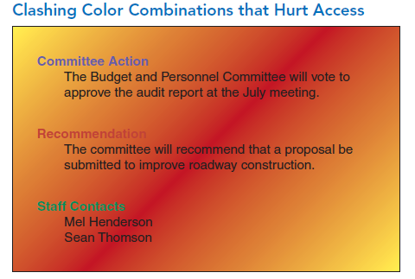
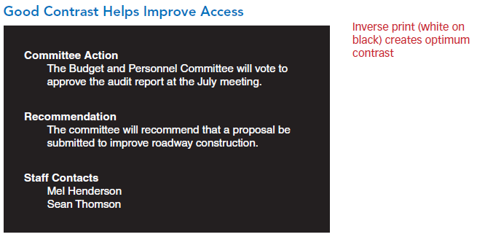
Inverse Print & Colour

Slide 10
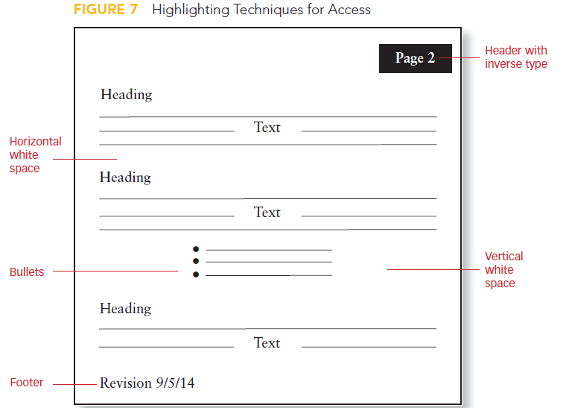

Slide 11
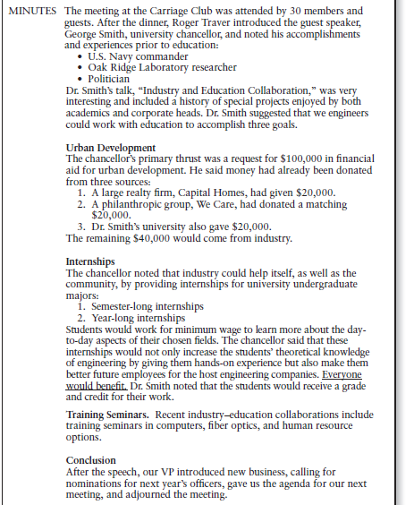

Slide 12
Variety
Choose a different page orientation. Rather than use portrait orientation (8½ * 11‐inch), you could choose landscape orientation (11 * 8½‐inch).
Use more columns. Provide your reader two to five columns of text.
Vary gutter width. Columns of text are separated by vertical white space called the gutter.
Use ragged‐right margins. Some text is fully justified (both right and left margins are aligned). Once this was considered professional, giving the text a clean look.
Now, however, studies confirm that right‐margin‐justified text is harder for the audience to read. It’s too rigid. In contrast, ragged‐right type (the right margin is not justified) is easier to read and more pleasing to the eye. You can use this method to vary page layout.

Slide 13
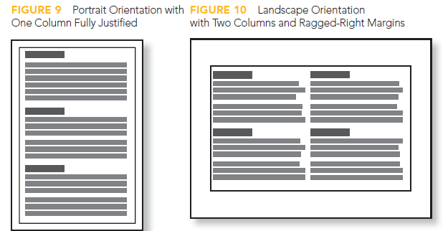

Slide 14
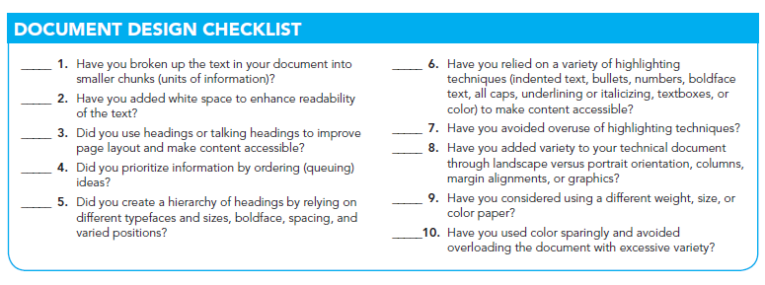

Slide 15

Any Questions

